Slide 1

Department of Mechanical Engineering
Mini Project
NIMBUS
Group No. 3
Presented by
HARSHIT KUMAR AZAD (2300320400024)
LAVESH KUMAR (2300320400034)
LAKSHAY BISHT (2300320400032)
HARSH CHAUDHARY (2300320400023)
HIMANSHU SINGH (2300320400026)
JIGYASH CHAUHAN (2300320400029)
KARAN GUPTA (2300320400031)
LAKSHAY SAXENA (2300320400033)
JUNAID FAROOQ (2300320400030)
JALALUDDIN (2300320400027)
JAY PRAKASH (2300320400028)
Guided by
Mr. MOHIT BANSAL
SIR

Slide 2

OBJECTIVE:-
To educate the audience on the importance of monitoring air quality through the Air Quality Index (AQI), explain the components and functioning of an AQI monitoring system, and highlight its role in promoting public health, environmental awareness, and data-driven policy decisions.

Slide 3
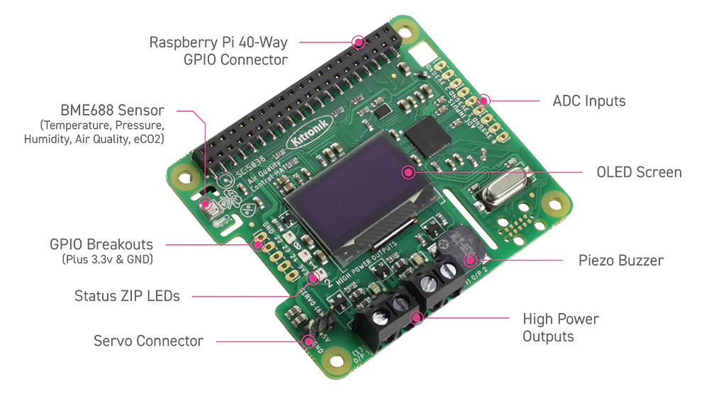
LITERATURE:-
Literature on Raspberry Pi-based air quality monitoring systems is extensive, focusing on.
Low-cost, real-time.
IOT-enabled solutions for monitoring various pollutants and calculating the (AQI).

Slide 4
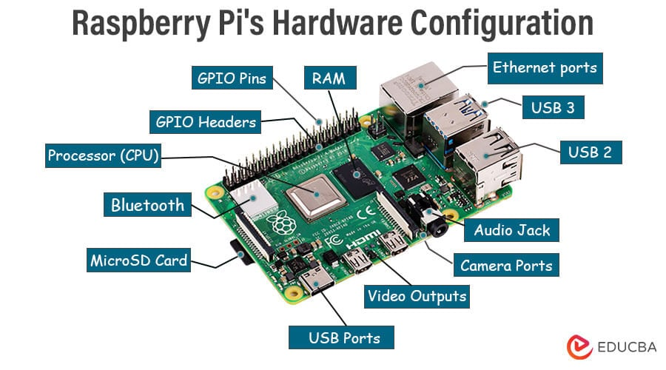
WORKING PRINCIPLE:-
An AQI monitoring device based on a Raspberry Pi works by Collecting air quality data from various sensors, processing this data to calculate the Air Quality Index (AQI).
The information then transmitting or displaying.

Slide 5
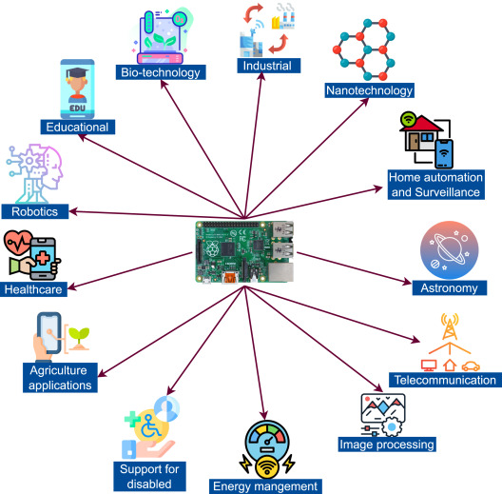
The Raspberry Pi acts as the central processing unit and an IoT gateway for the system.
Utilize advanced technology to detect and measure pollutants in the atmosphere.

Slide 6
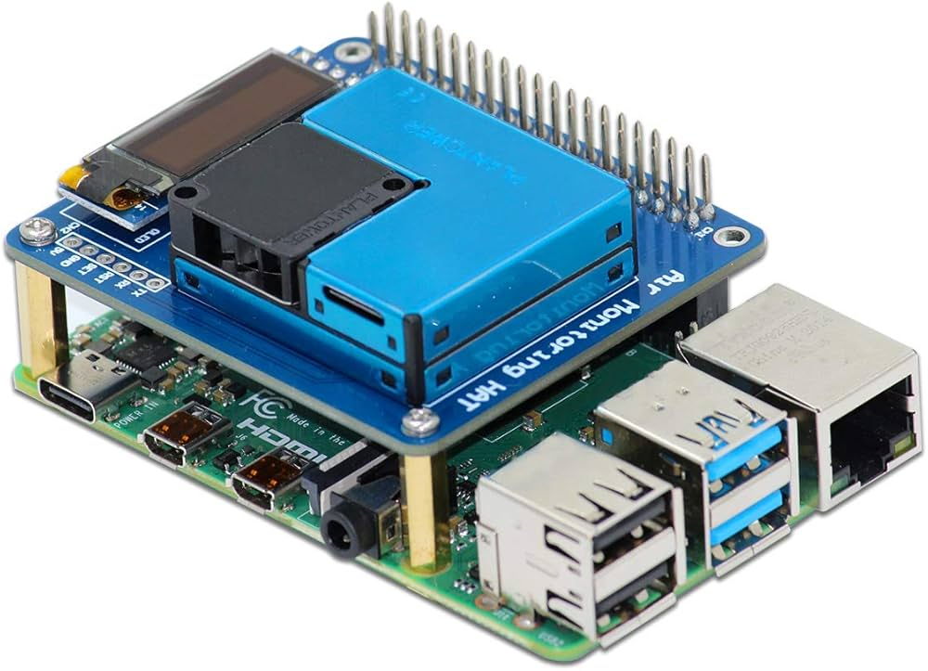
EQUIPMENT:-
Raspberry Pi Board:
A Raspberry Pi (Model 3, 4, 5, or Zero W are common choices) acts as the central processing unit.
Power Supply:
An appropriate 5V power supply (with adequate amperage) for your specific Raspberry Pi model.
MicroSD Card: Used for installing the Raspberry Pi OS
Jumper Wires and Breadboard: Essential for connecting the various sensors to the Raspberry Pi's GPIO pins.
Protective Case/Enclosure: To house and protect the components, ideally with good ventilation for the sensors.

Slide 7
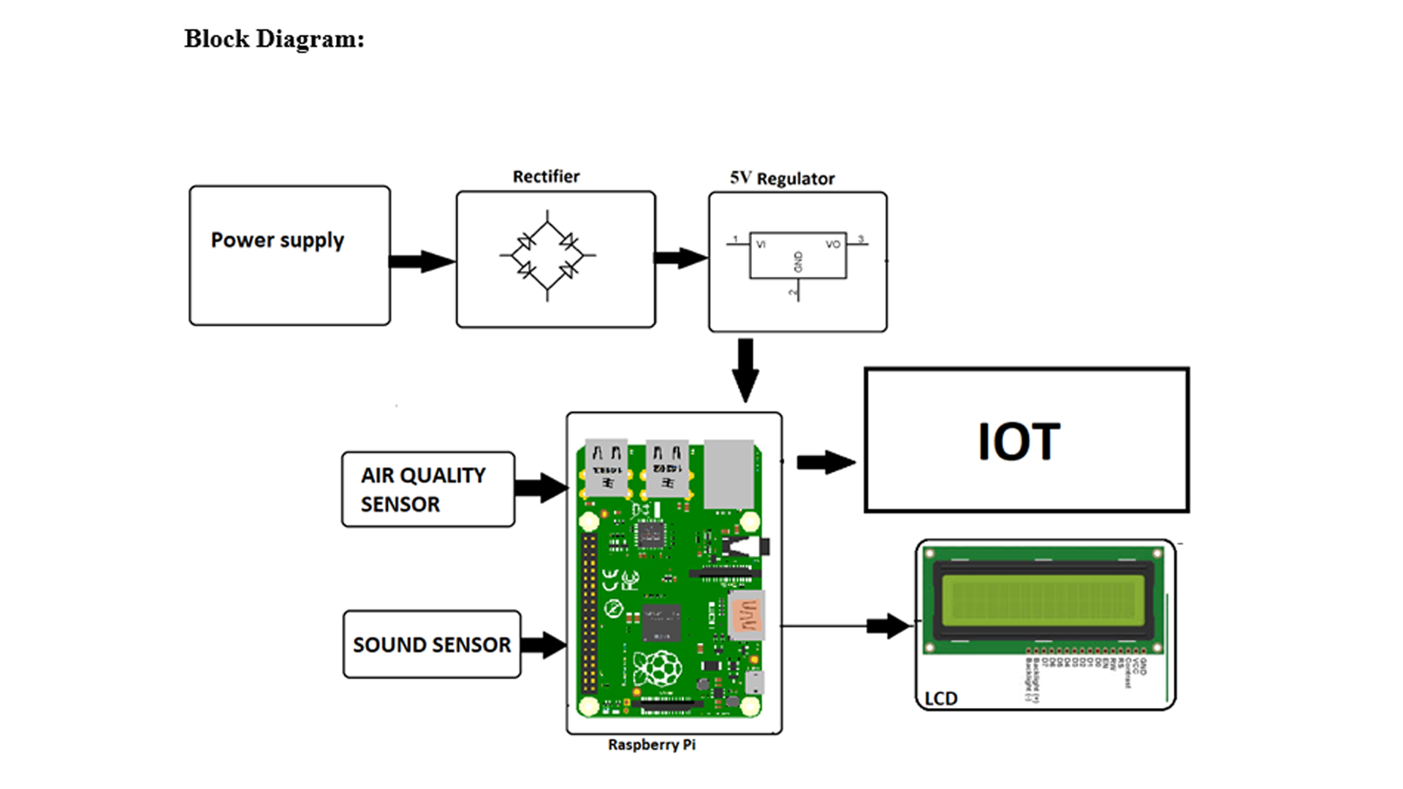
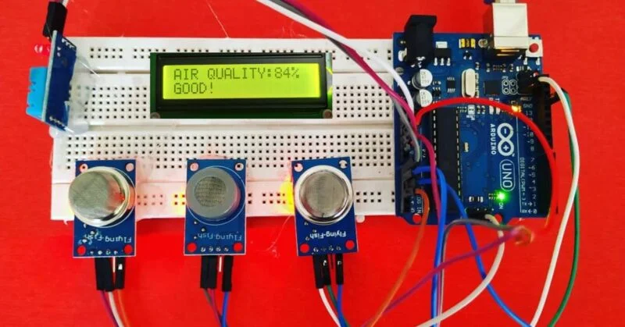
BLOCK DIAGRAM

Slide 8
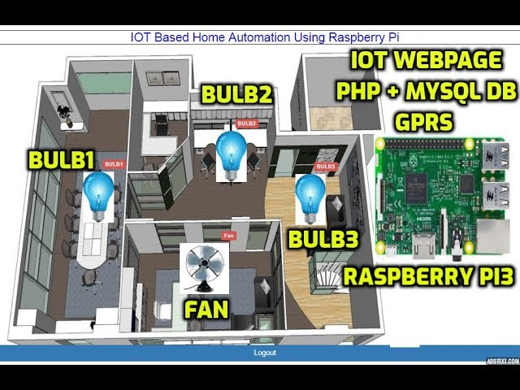
APPLICATION:-
Mobile monitoring: Mounted on unmanned aerial vehicles (UAVs) or vehicles
Home automation: Integrated into a smart home system, it can monitor indoor air quality and trigger actions like activating an air purifier.
Scientific research: Academic institutions and researchers can use these devices for field studies

Slide 9
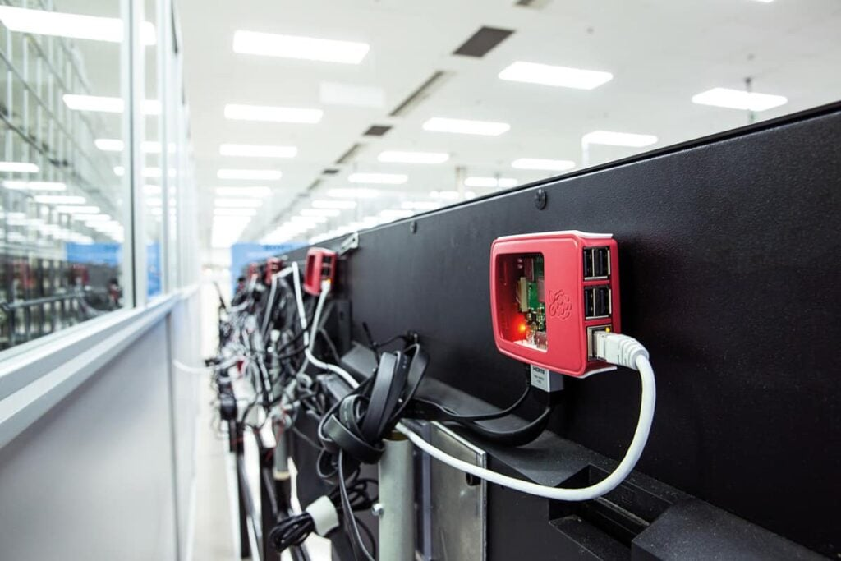
Urban monitoring: Deployed in cities, these devices can create detailed, real-time maps of air pollution hotspots to aid in city planning and public health initiatives.
Industrial and mining zones: Companies can use these systems to continuously monitor air quality in high-risk areas and ensure compliance with environmental regulations

Slide 10
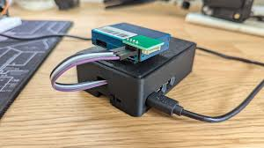
PURPOSE SOLUTION:-
Real-time Monitoring: The primary purpose is to collect data on pollutants PM2.5.
Health Protection: By providing real-time data and alerts when pollution levels exceed safe thresholds.
Cost-Effective Solution: DIY systems using a Raspberry Pi.
Data Analysis and Research: The collected data (often uploaded to cloud platforms via the IOT.
Automation and Control: The system can be integrated with home automation.
Educational Value: These projects offer significant educational value, providing hands-on experience in electronics, programming.

Slide 11
REFRENCE:-
YouTube: Channels like "Programming Electronics
Tech Blogs and Maker Websites: Websites like Medium.com and Nevonprojects.com host articles and project guides on building Raspberry Pi sensor networks for home automation and air quality monitoring
Research Gate & IEEE X plore: Scientific papers and conference publications detail
Developer Forums: Hub: Open-source code repositories are commonly shared on GitHub, providing the software backbone for these projects

Slide 12
The roles and responsibilities of each individual are:-
1. HARSHIT
•Leads the project
•Provides technical expertise
•Compiles research findings, experimental results, and design information
2. JIGYASU , HIMANSHU AND HARSH
•Tracks project expenses
•Ensure standards of experimental setup and error free data collection
•Work on Fabrication of experimental setup
3. LAKSHYA , LAKSHYA SAXENA AND JAY
•Research and compile findings, experimental results, and design information
•Provides technical expertise and assistance.
•Provides critical feedback ,improvement and clarification on data.
4. JUNAID AND JALALUDDIN, KARAN
•Manages the procurement of materials and equipment needed
•Conducts in-depth research and market survey on VCRS
•Provides technical expertise

Slide 13
